Slide 1
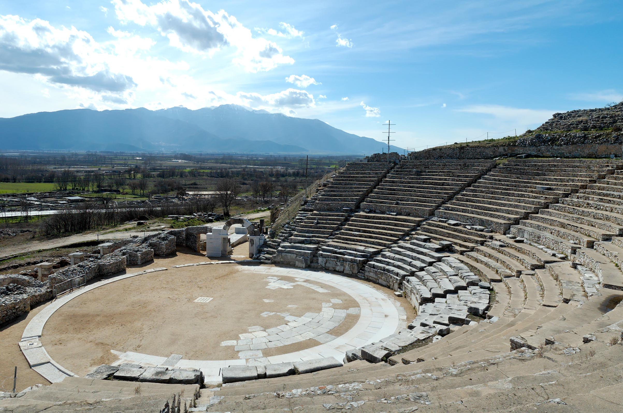
Philippians 1.18b-26
Theater in Philippi / Photo ©2012 Todd Bolen / BiblePlaces.com

Slide 2
Philippians 1.18b-20 NET: Yes, and I will continue to rejoice, for I know that this will turn out for my deliverance through your prayers and the help of the Spirit of Jesus Christ. My confident hope is that I will in no way be ashamed but that with complete boldness, even now as always, Christ will be exalted in my body, whether I live or die.

Slide 3
Philippians 1.18b-20 NET: Yes, and I will continue to rejoice, for I know that this will turn out for my deliverance through your prayers and the help of the Spirit of Jesus Christ. [according to] My confident hope [which] is that I will in no way be ashamed but that with complete boldness, even now as always, Christ will be exalted in my body, whether I live or die.

Slide 4
Philippians 1.18b-20 NET: Yes, and I will continue to rejoice, for I know that this will turn out for my deliverance through your prayers and the help of the Spirit of Jesus Christ [according to] My confident hope [which] is that I will in no way be ashamed but that with complete boldness, even now as always, Christ will be exalted in my body, whether I live or die.

Slide 5
Philippians 1.18b-20 NET: Yes, and I will continue to rejoice, for I know that this will turn out for my deliverance through your prayers and the help of the Spirit of Jesus Christ [according to] My confident hope [which] is that I will in no way be ashamed but that with complete boldness, even now as always, Christ will be exalted in my body, whether I live or die.

Slide 6
Philippians 1.18b-20 NET: Yes, and I will continue to rejoice, for I know that this will turn out for my deliverance through your prayers and the help of the Spirit of Jesus Christ [according to] My confident hope [which] is that I will in no way be ashamed but that with complete boldness, even now as always, Christ will be exalted in my body, whether I live or die.

Slide 7
Philippians 1.18b-20 NET: Yes, and I will continue to rejoice, for I know that this will turn out for my deliverance through your prayers and the help of the Spirit of Jesus Christ [according to] My confident hope [which] is that I will in no way be ashamed but that with complete boldness, even now as always, Christ will be exalted in my body, whether I live or die.

Slide 8
Philippians 1.18b-20 NET: Yes, and I will continue to rejoice, for I know that this will turn out for my deliverance through your prayers and the help of the Spirit of Jesus Christ. My confident hope is that I will in no way be ashamed but that with complete boldness, even now as always, Christ will be exalted in my body, whether I live or die.

Slide 9
Philippians 1.21-26 NET: For to me, living is Christ and dying is gain. Now if I am to go on living in the body, this will mean productive work for me, yet I don't know which I prefer: I feel torn between the two, because I have a desire to depart and be with Christ, which is better by far, but it is more vital for your sake that I remain in the body. And since I am sure of this, I know that I will remain and continue with all of you for the sake of your progress and joy in the faith, so that what you can be proud of may increase because of me in Christ Jesus, when I come back to you.

Slide 10
Philippians 1.21-26 NET: For to me, living is Christ and dying is gain. Now if I am to go on living in the body, this will mean productive work for me, yet I don't know which I prefer: I feel torn between the two, because I have a desire to depart and be with Christ, which is better by far, but it is more vital for your sake that I remain in the body. And since I am sure of this, I know that I will remain and continue with all of you for the sake of your progress and joy in the faith, so that what you can be proud of may increase because of me in Christ Jesus, when I come back to you.

Slide 11
Philippians 1.21-26 NET: For to me, living is Christ and dying is gain. Now if I am to go on living in the body, this will mean productive work for me, yet I don't know which I prefer: I feel torn between the two, because I have a desire to depart and be with Christ, which is better by far, but it is more vital for your sake that I remain in the body. And since I am sure of this, I know that I will remain and continue with all of you for the sake of your progress and joy in the faith, so that what you can be proud of may increase because of me in Christ Jesus, when I come back to you.

Slide 12
Philippians 1.21-26 NET: For to me, living is Christ and dying is gain. Now if I am to go on living in the body, this will mean productive work for me, yet I don't know which I prefer: I feel torn between the two, because I have a desire to depart and be with Christ, which is better by far, but it is more vital for your sake that I remain in the body. And since I am sure of this, I know that I will remain and continue with all of you for the sake of your progress and joy in the faith, so that what you can be proud of may increase because of me in Christ Jesus, when I come back to you.

Slide 13
Philippians 1.21-26 NET: For to me, living is Christ and dying is gain. Now if I am to go on living in the body, this will mean productive work for me, yet I don't know which I prefer: I feel torn between the two, because I have a desire to depart and be with Christ, which is better by far, but it is more vital for your sake that I remain in the body. And since I am sure of this, I know that I will remain and continue with all of you for the sake of your progress and joy in the faith, so that what you can be proud of may increase because of me in Christ Jesus, when I come back to you.

Slide 14
Philippians 1.25-26 NET: And since I am sure of this, I know that I will remain and continue with all of you for the sake of your progress and joy in the faith, so that what you can be proud of may increase because of me in Christ Jesus, when I come back to you.
καύχημα = the reason for boasting
περισσεύω = abound

Slide 15
Jeremiah 9.23-24 NLT: This is what the LORD says: “Don't let the wise boast in their wisdom, or the powerful boast in their power, or the rich boast in their riches. But those who wish to boast should boast in this alone: that they truly know me and understand that I am the LORD who demonstrates unfailing love and who brings justice and righteousness to the earth, and that I delight in these things. I, the LORD, have spoken!”

Slide 16
AD62: set free in Rome.
Travel to Crete [Titus 1.5], Nicopolis [Titus 3.12], Miletus and Troas [2 Timothy 4.13, 20], and Macedonia [1 Timothy 1.3] which suggests at least Philippi & Thessalonica.
His disciple, Clement, said he did get to Spain.
AD67[?]: killed in Rome.
map from Carol Rasmussen
Zondervan Atlas of the Bible p.228

Slide 17
Philippians 1.1-11: Paul was confident that God would ensure the Philippians continued to do the work of the gospel mission in partnership with Paul.
1.12: Assurance Paul’s imprisonment resulted in
advance [προκοπή] of the gospel mission.
1.25-26: Assurance Paul’s release will result in
advance [προκοπή] in their faith and mission.

Slide 18
Philippians 1.18b-26
Theater in Philippi / Photo ©2012 Todd Bolen / BiblePlaces.com

